Slide 1
National Scholarship Portal
DBT Mission Cabinet Secretariat

Slide 2
Declaration by Applicant

Slide 4
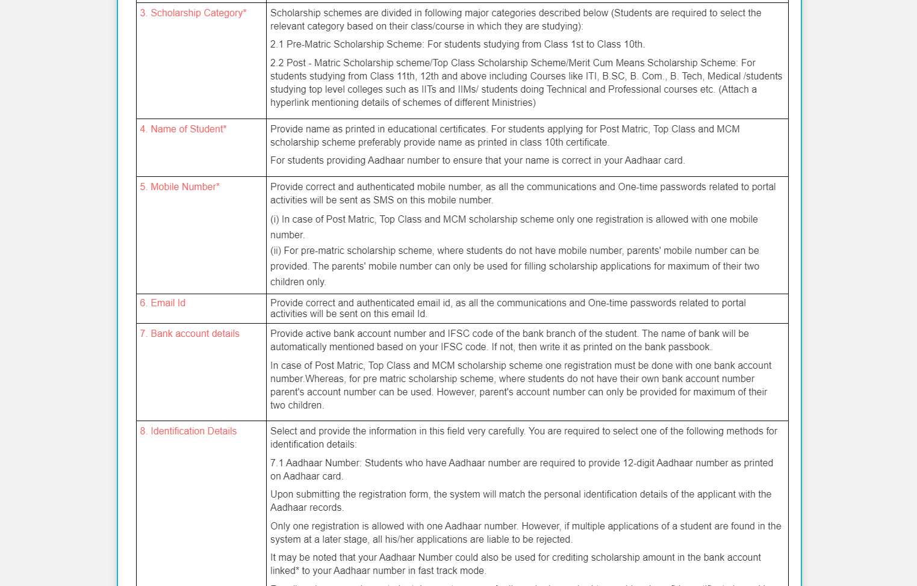

Slide 5
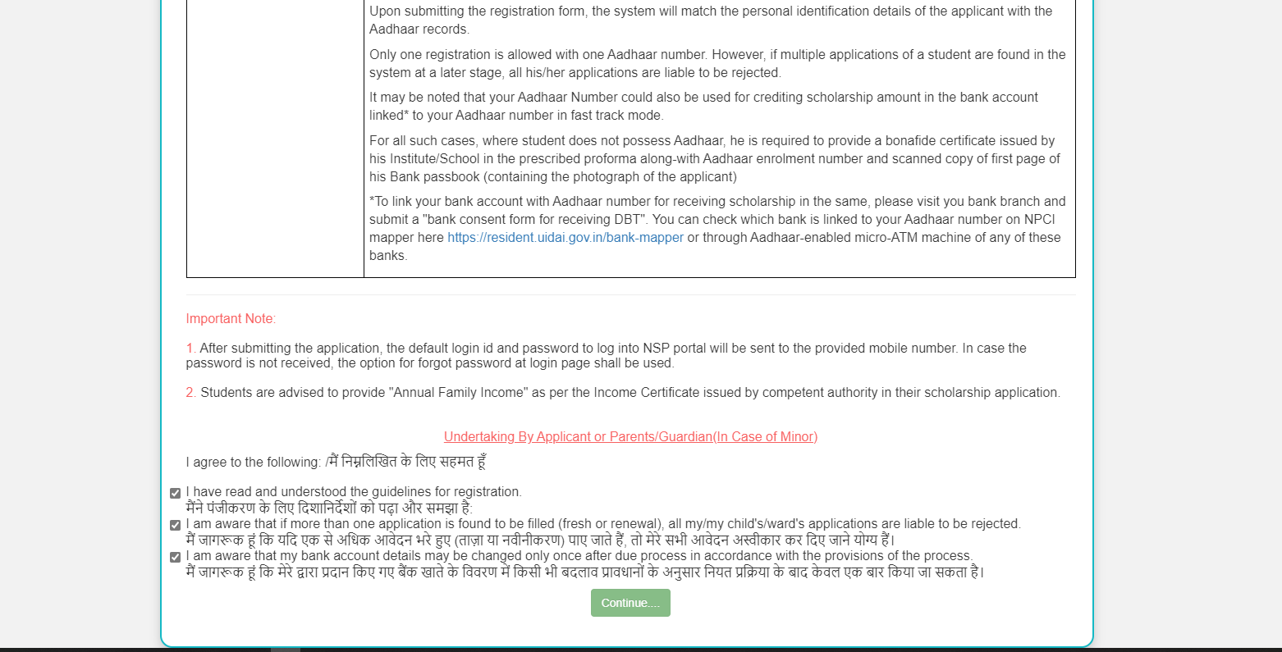

Slide 6
AY 2020-21 Registration Process

Slide 7
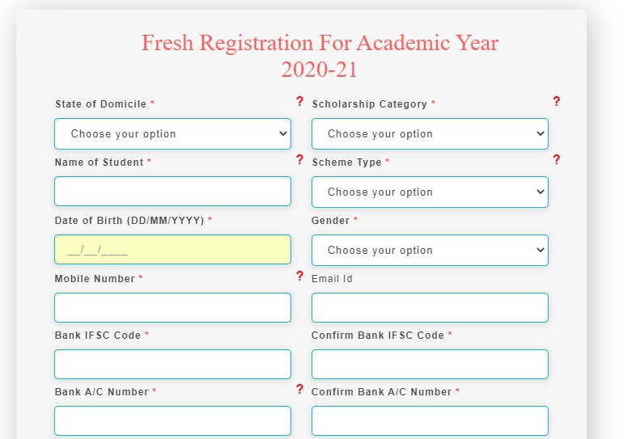

Slide 8
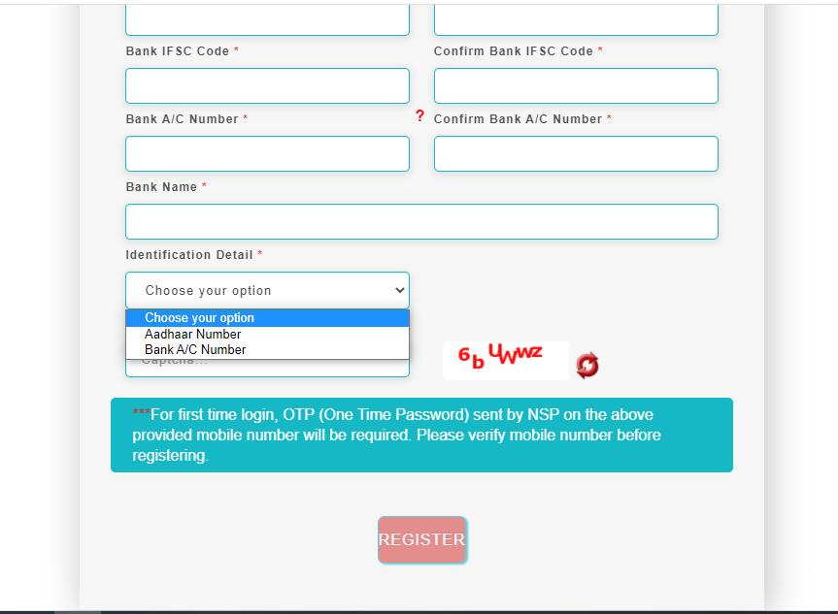

Slide 11
New Registration Process

Slide 12
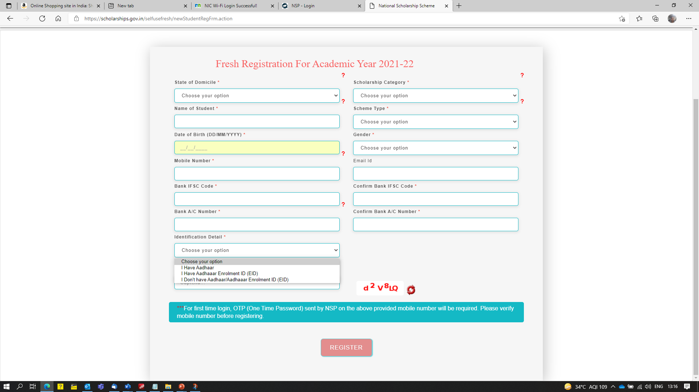
Aadhaar
Aadhaar enrolment ID (EID)
Bank Account (In case you don’t have Aadhaar)

Slide 13
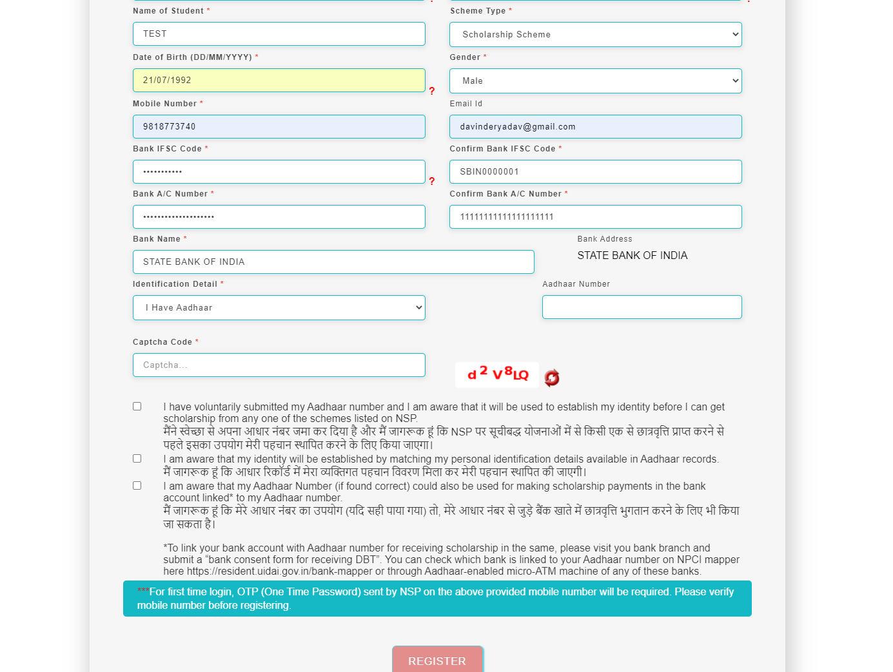
Aadhar

Slide 14
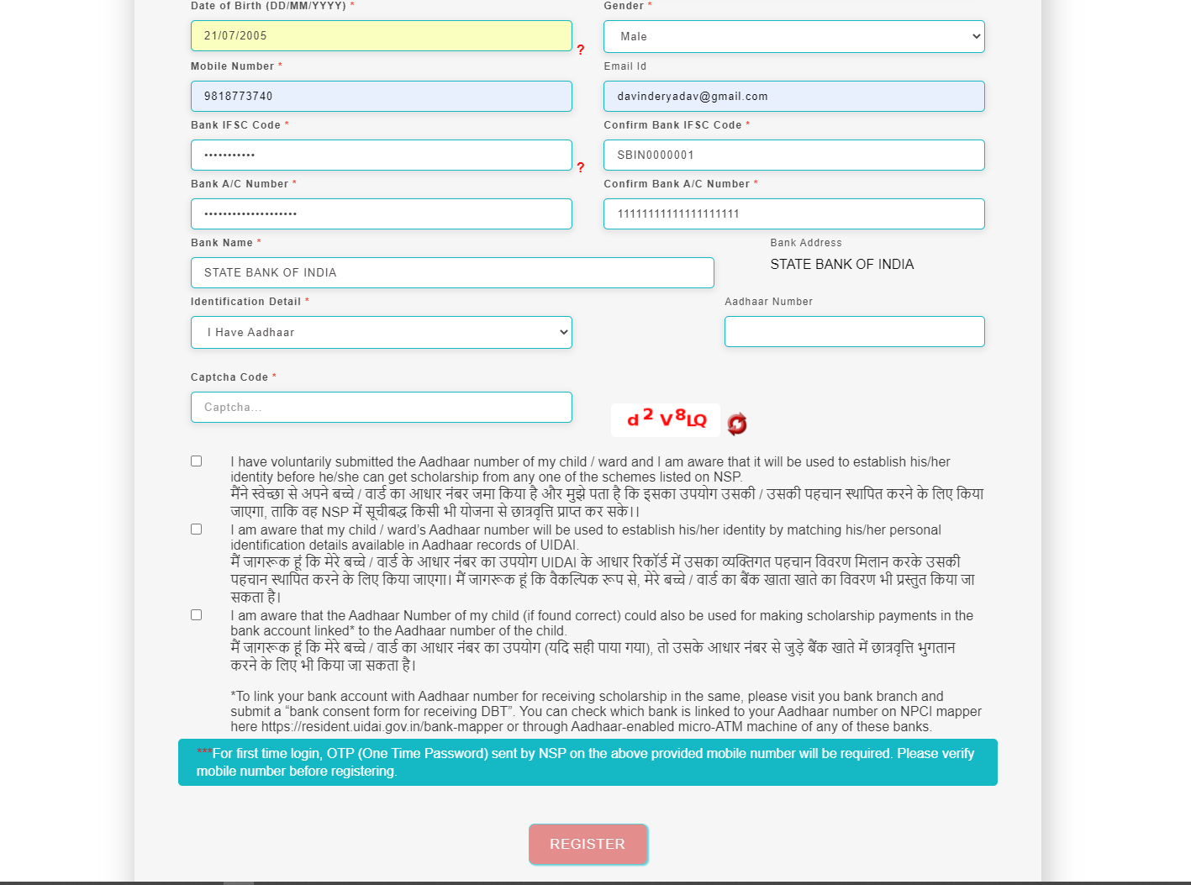
Aadhar

Slide 15
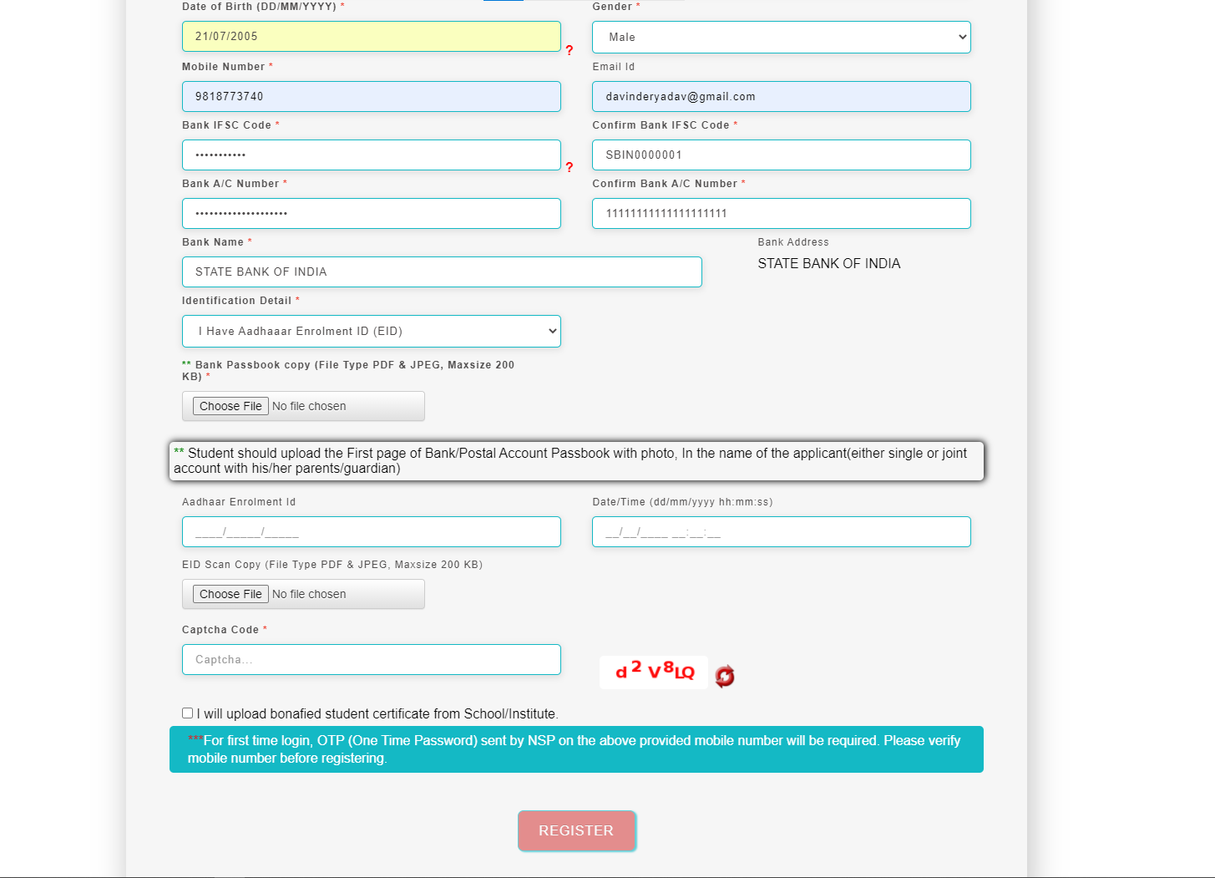
Aadhar Enrolment ID (EID)
( with photo ) , in
bonafide

Slide 16
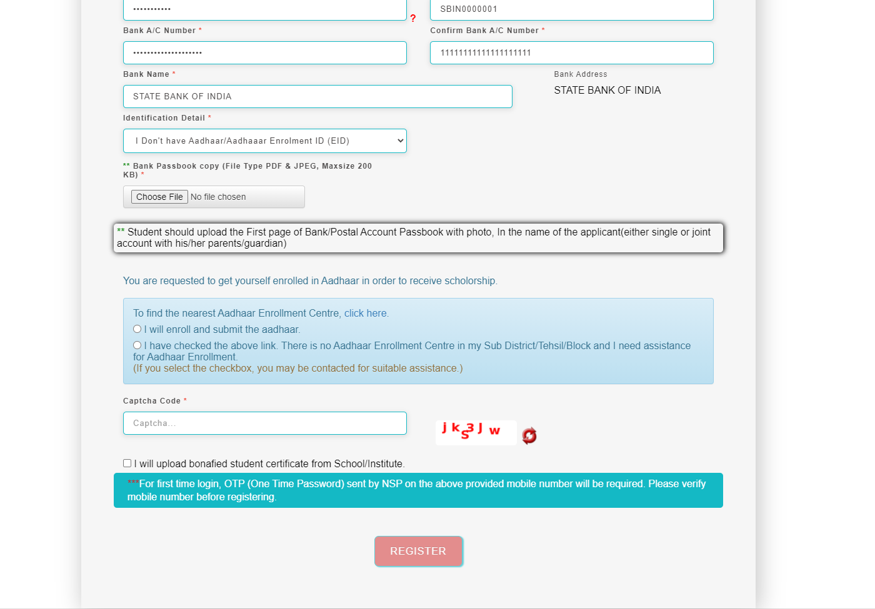
Bank Account (in case you don’t have Aadhaar)
( with photo ) , in
bonafide

Slide 17
For UT of J&K, UT of Ladakh, Assam and Manipur
Bank Account (in case you don’t have Aadhaar)
Bank Account (in case you don’t have Aadhaar)
( with photo ) , in
bonafide

Slide 18
Changes in the Application form
ACADEMIC YEAR 2021-2022

Slide 19
Application Form Of Student
Introduction of entry of Ration card member id for students of Tripura

Slide 20
General Information and Selection Of Institute Contd..
POST MATRIC/TOP CLASS/ MCM
Selection of Institute by student

Slide 21
Institute Selection By The Student Contd..

Slide 22
Click on select according to the selection of the Institute Contd..
Click on select button after the selection of the Institute

Slide 23
After selecting, the Institute name will come under Academic details Contd..
Institute Name
Entry of Admission /Enrollment/Registration no and admission Year, roll no and section of students

Slide 24
Fill Other Details and Click Save and Continue Contd..
Select Institute Name

Slide 25
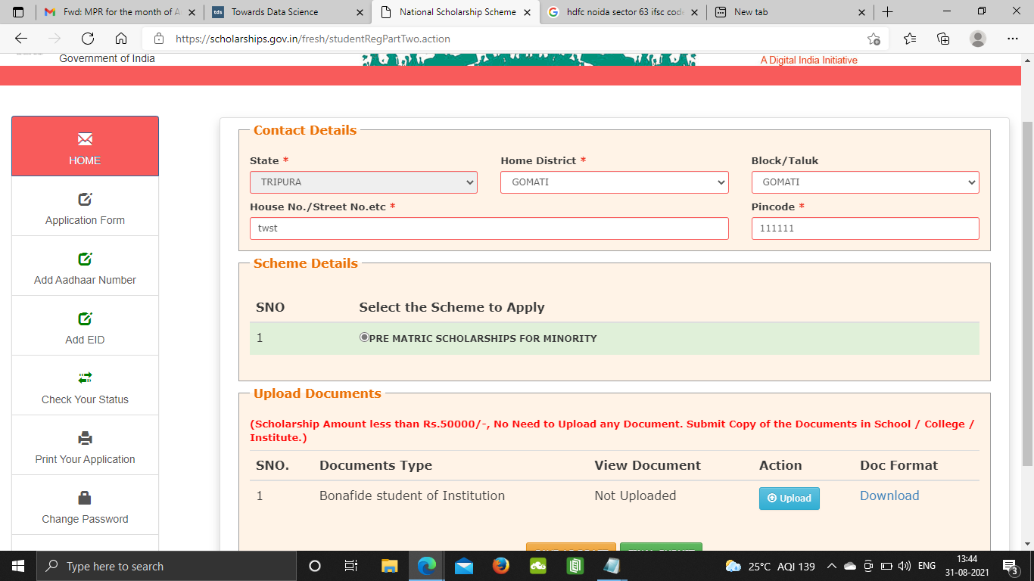
The eligible schemes based on entered criteria is displayed here
i.e National Fellowship and Scholarship for Higher Education of ST Students - Scholarship (Formally Top Class Education for Schedule Tribe Students

Slide 26
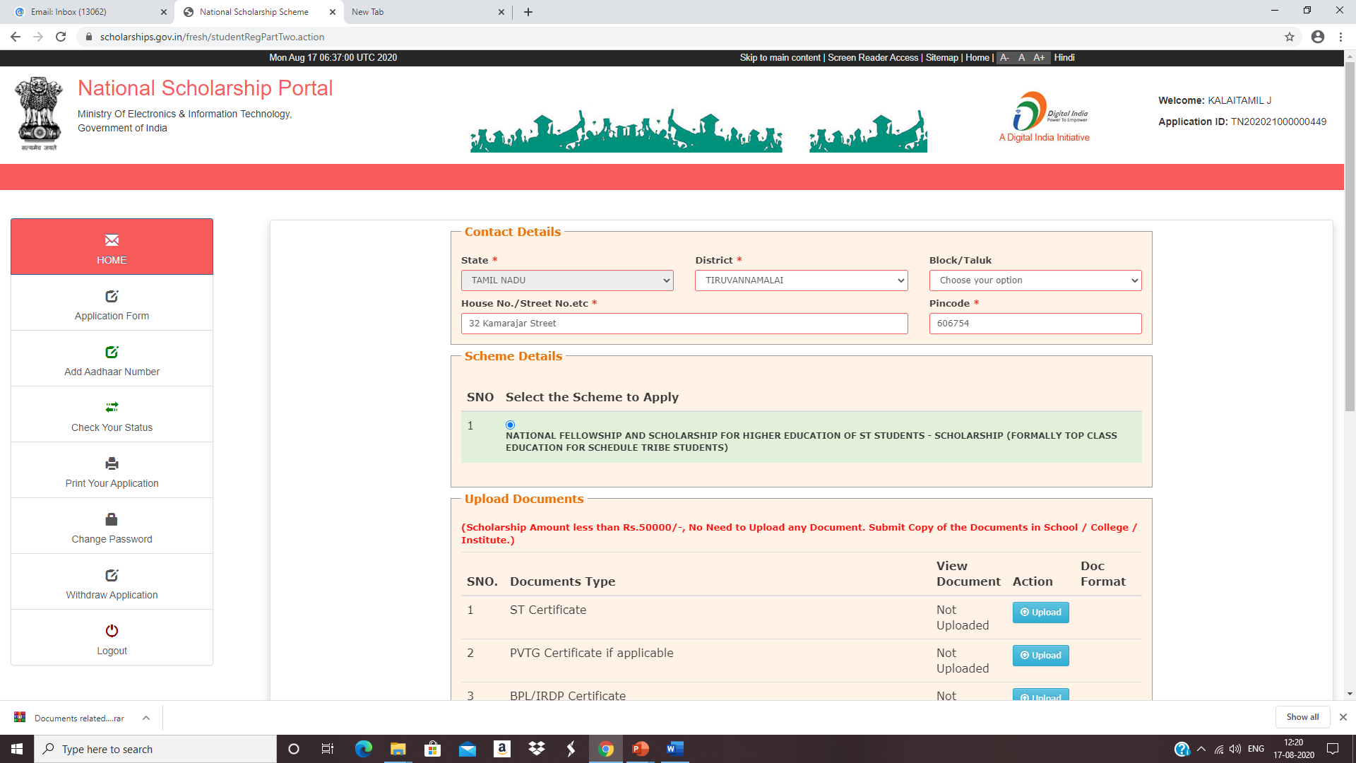
For Example

Slide 27
Fill the information and click upload now Contd..

Slide 28
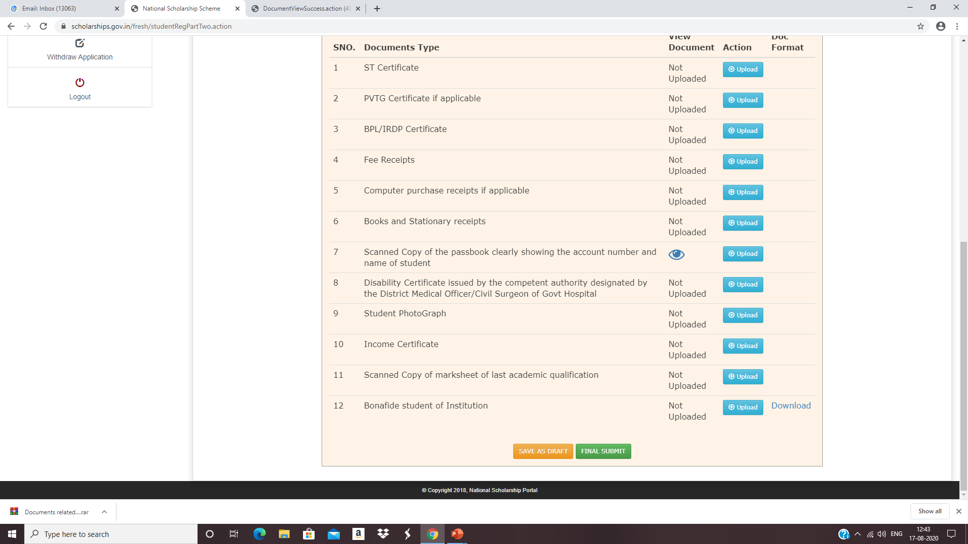
If you want to view your documents click this icon
If you are sure of the details entered, click on “FINAL SUBMIT” to submit the form. Upon final submit, you will not be able to edit the form again.
Please click on “SAVE AS DRAFT” if you are not clear about any details entered and you want to edit the form later.

Slide 29
Student Application Form Details Contd..
Scheme -National Fellowship and Scholarship for Higher Education of ST Students - Scholarship (Formally Top Class Education for Schedule Tribe Students)

Slide 30
Contd..

Slide 31
Click on print option for taking out the print

Slide 32
Click on save to take out the Print Of the Form

